Slide 1

Beauty Products e-Store Project Group-6 Presented By: Bhumika Suvagia (Team Leader) Ankita Savaliya (Database Developer) Akanksha Khaire (Database Developer)

Slide 2

Agenda
Introduction
Database Design
Relational Database using Referential Integrity
Normalization
SQL
PL/SQL
Need, Requirements and Functionality
ORDBMS
Learned Skills and Future Improvements

Slide 3

Purpose: To develop a database for an e-store that sells beauty products globally to improve efficiency and manage information flow. Database Components: Employees, beauty products inventory, orders, customers, and suppliers. Product Categories: Each category has a distinct name and number with its own set of products, including name, description, price, and image. Inventory Management: Records are kept of the number of products available in stock, sold, and on order from suppliers. Suppliers: Multiple suppliers are sourced for the products. Records are kept of the name, tracking information, and products supplied by each supplier. Customers: Customers can create accounts and place orders. Records are kept of their name, contact information, shipping and billing addresses, and order history. Order Tracking: Each order has a unique order number, date, and status with records of the amount for each order.
Introduction

Slide 4
Need, Requirements and Functionality
Need:
The e-store needs a database to manage its operations efficiently and to keep track of its employees, inventory, orders, customers, and suppliers.
The database provides a secure platform to store and manage information and improve the flow of information between different parts of the business.
Requirements:
We require the database to handle a high volume of data and transactions from multiple sources.
It is easy to use and provides a user-friendly interface for employees to input and access data. It is secure, with restricted access to sensitive information.
It is scalable to accommodate the growth of the business over time.
Functionality:
The database provides a platform to manage employee information, such as their personal data and roles within the organization
The database enables the e-store to manage its inventory efficiently, keeping track of stock levels, sales, and orders from suppliers.
The database provides a platform for customers to create accounts, place orders, and view their order history.
The database enables the e-store to manage its supplier information, such as their contact details and the products supplied.
The database provides a platform for generating reports on inventory, sales, and other metrics to help the business make informed decisions.

Slide 5

Need: The e-store needs a database to manage its operations efficiently and to keep track of its employees, inventory, orders, customers, and suppliers. -->The database provides a secure platform to store and manage information and improve the flow of information between different parts of the business. Requirements: -->We require the database to handle a high volume of data and transactions from multiple sources. -->It is easy to use and provides a user-friendly interface for employees to input and access data. It is secure, with restricted access to sensitive information. -->It is scalable to accommodate the growth of the business over time. Functionality: -->The database provides a platform to manage employee information, such as their personal data and roles within the organization. -->The database enables the e-store to manage its inventory efficiently, keeping track of stock levels, sales, and orders from suppliers. -->The database provides a platform for customers to create accounts, place orders, and view their order history. -->The database enables the e-store to manage its supplier information, such as their contact details and the products supplied. -->The database provides a platform for generating reports on inventory, sales, and other metrics to help the business make informed decisions.
Need, Requirements and Functionality

Slide 6
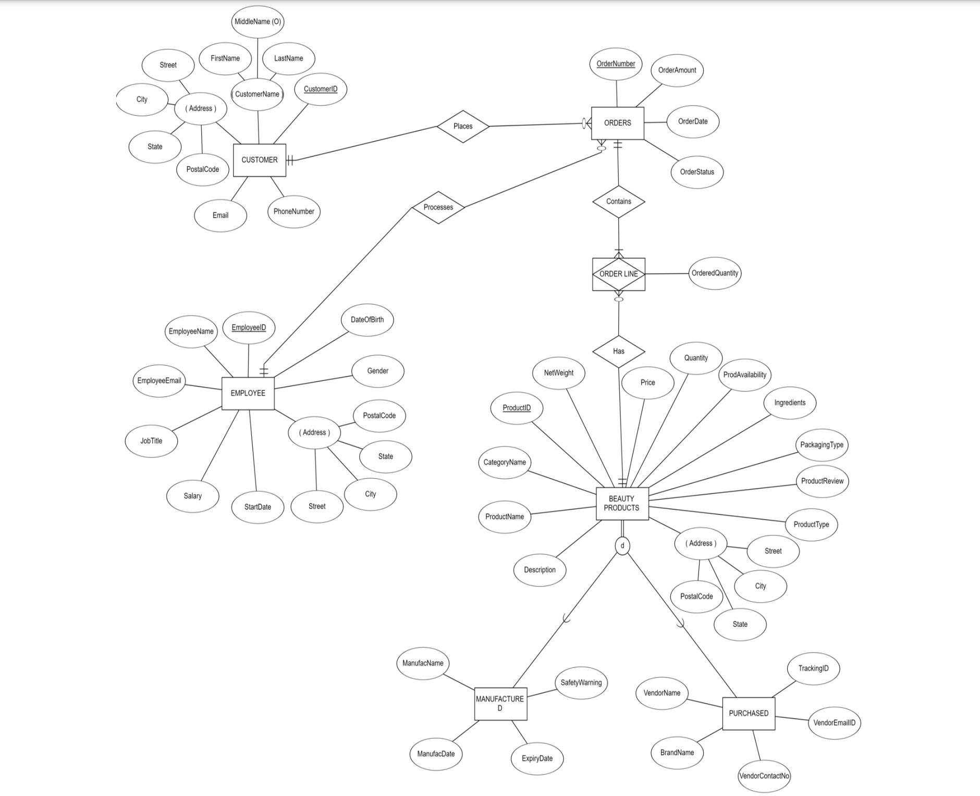
ERD DIAGRAM Description of Entity Type Relationship Type Keys/cardinality Constraints
Database Design

Slide 7
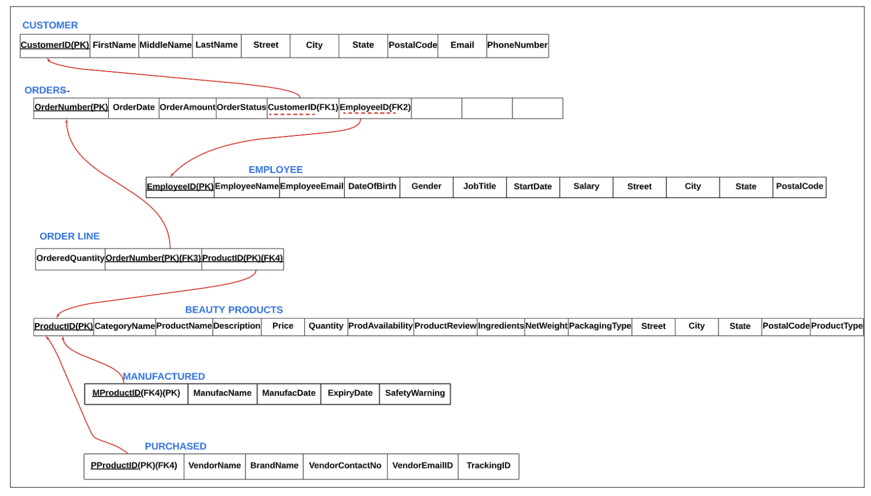
Relational Database using Referential Integrity Identifying Primary key and Foreign key

Slide 8
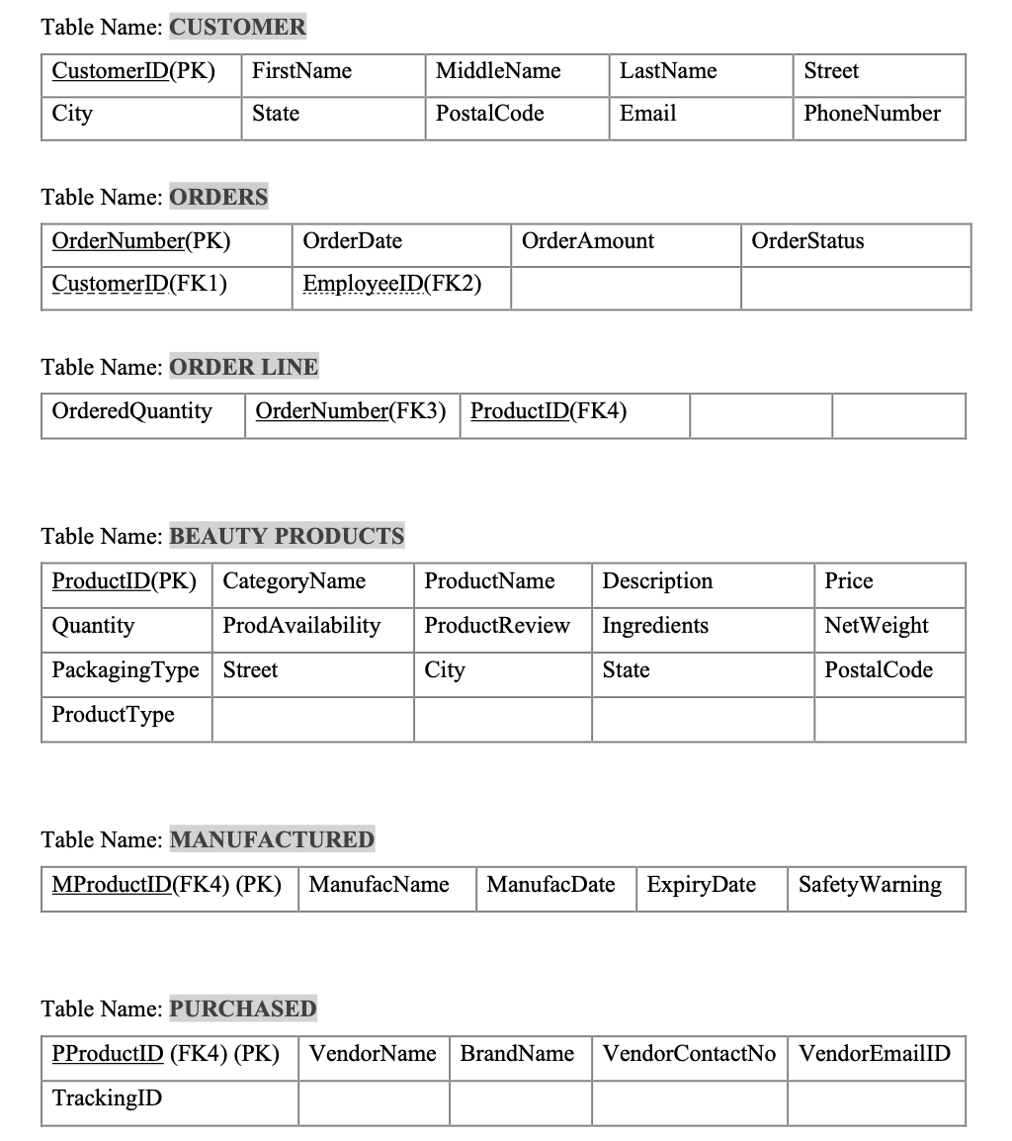
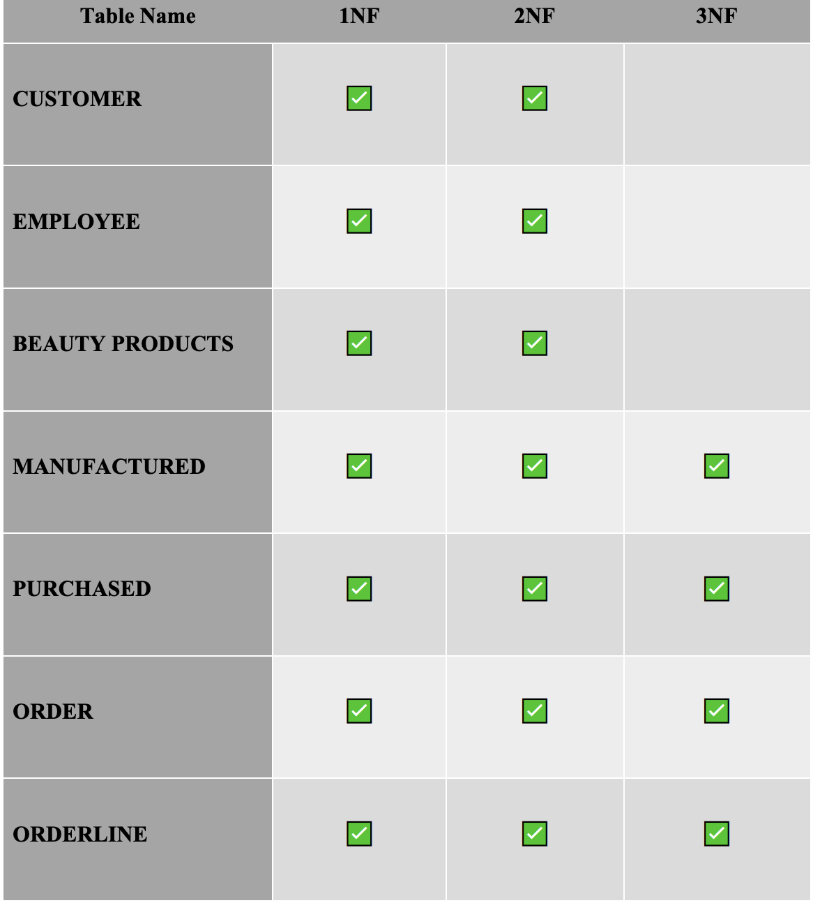
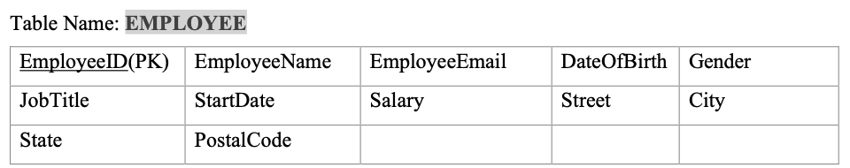
Normalization
Relational schema after normalization:
Customer, Employee and Beauty Products tables are not in the 3NF Form as they have transitive dependency
PostalCode->City, State
Decomposition of the relational schema to perform the normalization

Slide 9
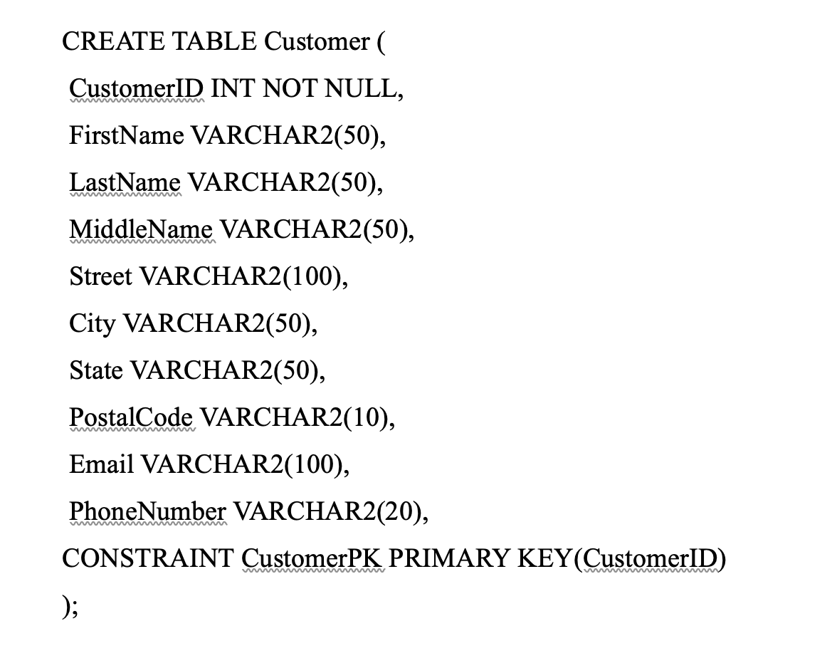
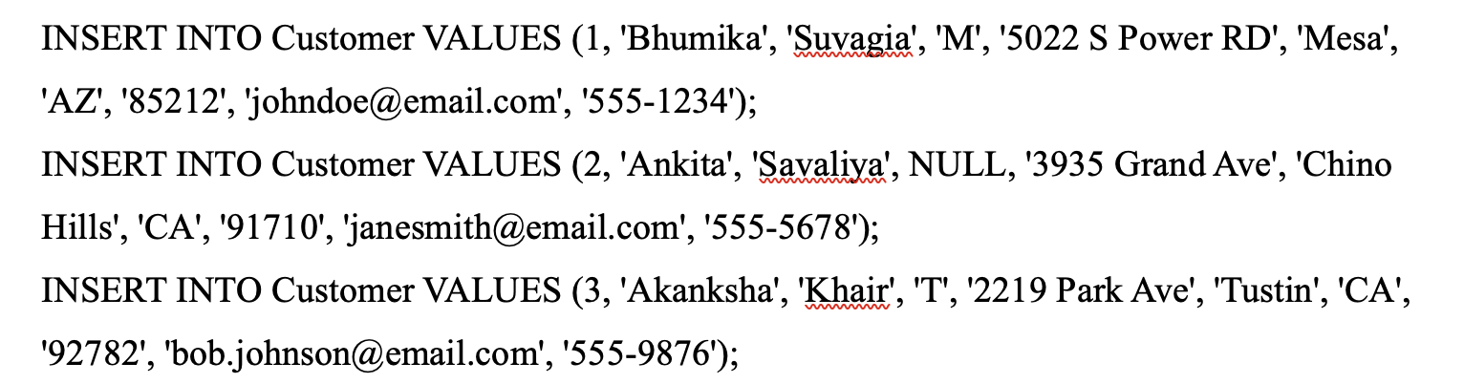
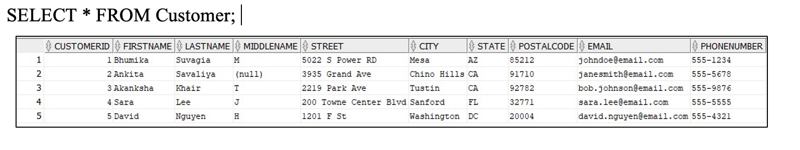
SQL Statements
CREATE Table & INSERT Rows
Syntax:
CREATE TABLE table_name ( column1 datatype, column2 datatype, column3 datatype, .... );
INSERT INTO table_name (column1, column2, column3, ...) VALUES (value1, value2, value3, ...);
Syntax:
SELECT * FROM table_name;

Slide 10
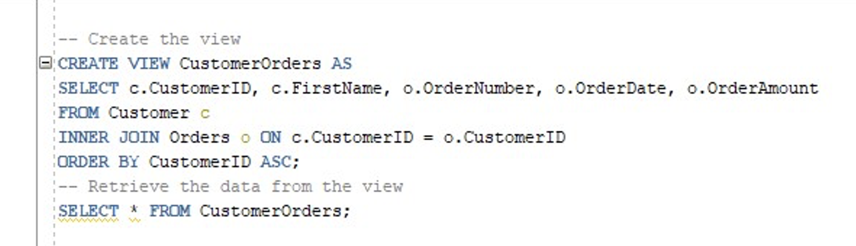
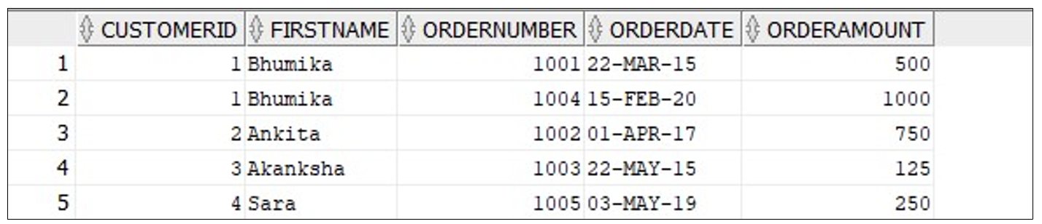
Create View, Join, Order By Statement
Statement:
A view is a database object that does not store data on its own, but instead provides a logical representation of data from one or more tables or other views in the database.
A join operation in SQL is used to combine two or more tables based on a related column(s) and create a new result set.
The ORDER BY keyword is used to sort the result-set in ascending or descending order.
Output:

Slide 11
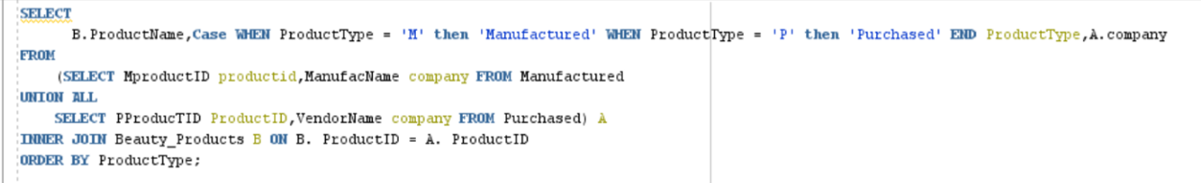
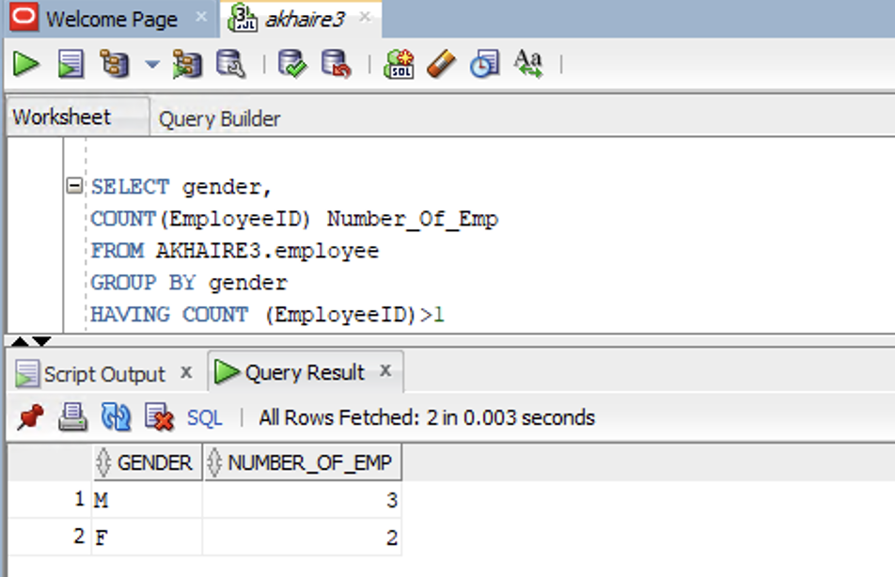
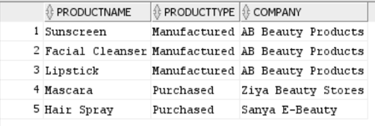
Subquery and Group By Statement
A subquery, also known as an inner query or a nested query, is a query that is nested inside another SQL statement, such as a SELECT, UPDATE, or DELETE statement.
The subquery (inner query) executes once before the main query (outer query) executes.
The main query (outer query) use the subquery result.
The GROUP BY clause in SQL is used to group rows in a table based on one or more columns.
It is often used in conjunction with aggregate functions such as SUM, COUNT, AVG, MAX, and MIN to perform calculations on the grouped data.
When a GROUP BY clause is used, the result set is divided into groups, where each group represents a unique combination of the values in the specified columns.
Statement:​
Statement:
Output
Output

Slide 12
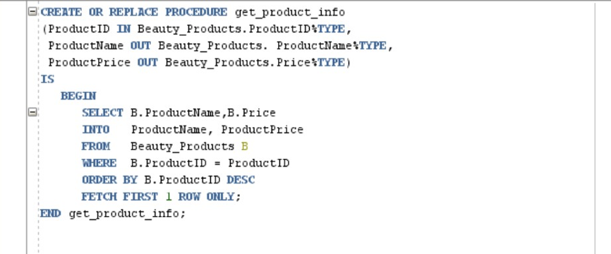
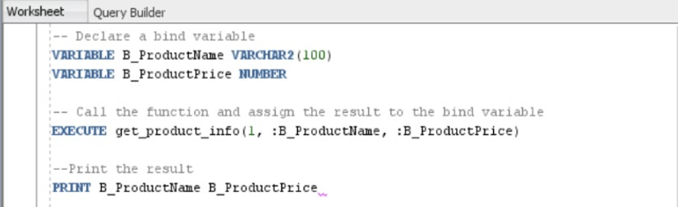

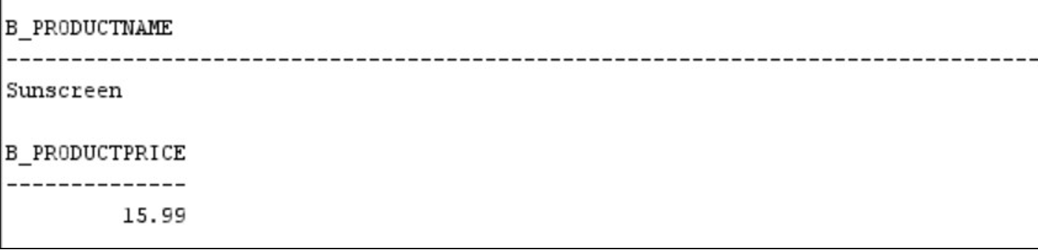
PL/SQL Statement
PL/SQL is Oracle’s procedural language, extension to SQL.
It is used to develop the smallest meaningful grouping of code is known as a block. A block is a unit of code that provides execution and scoping boundaries for variable declarations and exception handling
It allows you to create anonymous blocks (blocks of code that have no name) and named blocks, which may be packages, procedures, functions, triggers, or object types.​
The named block allows the user to store compiled code in the database. Therefore, any number of applications can access and share functions and procedures.​
​
Creating Procedure:
Calling the procedure:
Output:

Slide 13
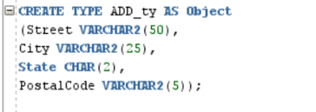
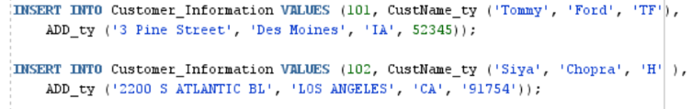
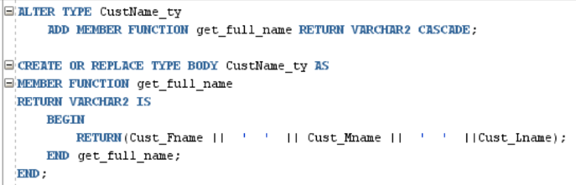
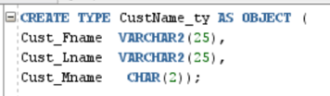

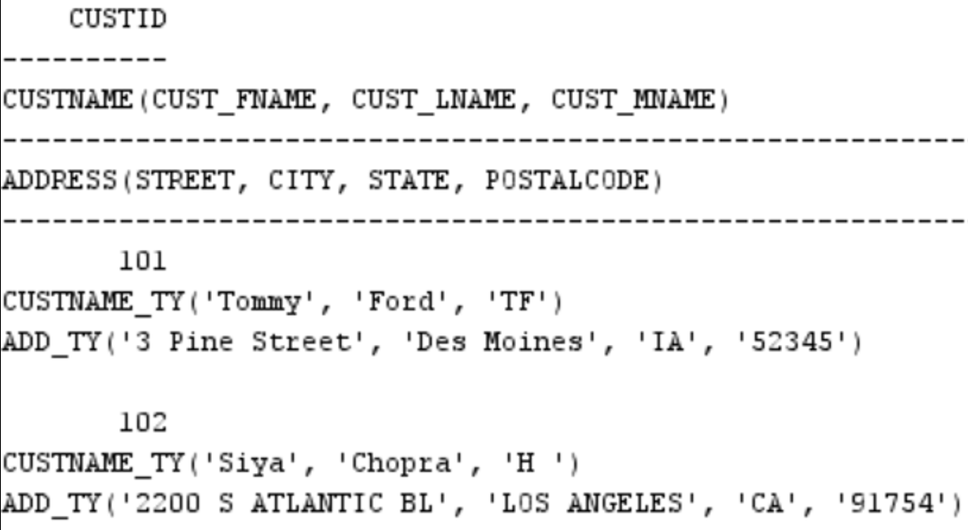
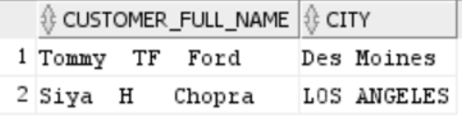
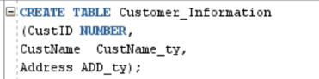
Object-Relational Database Management System
ORDBMS is a database management system (DBMS) similar to a relational database, but with an object-oriented database model: objects, classes and inheritance are directly supported in database schemas and in the query language.
It is used to process more complex data and queries.
Supports some object-oriented principles such as encapsulation, inheritance and reuse.
User-defined Function using Object-Oriented Principle(reuse):
Object Type​:
Insertion:
Retrieve Data:
Show Data:
Output:
Table using Pre-defined Object Type:
Output:

Slide 14
Learned Skills and Future Improvements
Learnt skills:
Organizing and managing data in a database.
Creating tables, views, procedures, functions, and ORDBMS.
Learnt DDL, DCL and DML using SQL commands.
Key Learnings:
Improved understanding of database management.
Ability to create effective data structures.
Efficient data retrieval and manipulation capabilities.
Enhanced knowledge of data modeling and design principles.
Additional learned concepts:
ER Diagram:
Helped visualize entity relationships.
Guided representation in the database.
Referential Integrity:
Ensured data consistency and accuracy.
Maintained relationships between tables.
Normalized Table:
Reduced data redundancy.
Ensured data consistency by organizing data into separate tables.
Crucial in database design:
Essential for creating an efficient and effective database application.
Areas for Future Improvements:
Performance tuning and optimization.
Query optimization.
Reducing data duplication.
Improving database performance.
Data analysis and reporting.
Importance of Improving Skills:
Ensures efficient database performance.
Provides valuable insights into the data.
Facilitates data-driven decision-making.

Slide 15

Thank you!

